Slide 1
IBPSES
CT104-3-2-VD1
SAP GUI NAVIGATION
Prepared by: NKN First Prepared on: 01.01.12 Last Modified on: 01.02.18
Quality checked by: SKS
Copyright 2012 Asia Pacific University of Technology and Innovation

Slide 2
Course Overview
Navigation

Slide 3
Content
User guidance
User specific settings
Navigation in SAP Easy Access Menu
Help

Slide 4
Learning Targets
At the end of this chapter you can
name the window elements,
navigate in an SAP system,
apply personal system settings,
effectively use help.

Slide 5
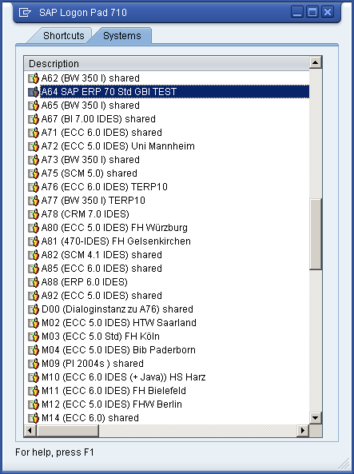
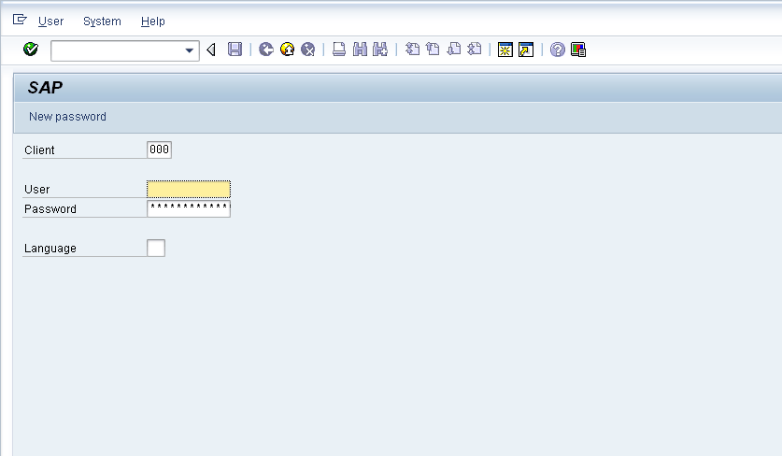
Log on to an SAP system

Slide 6
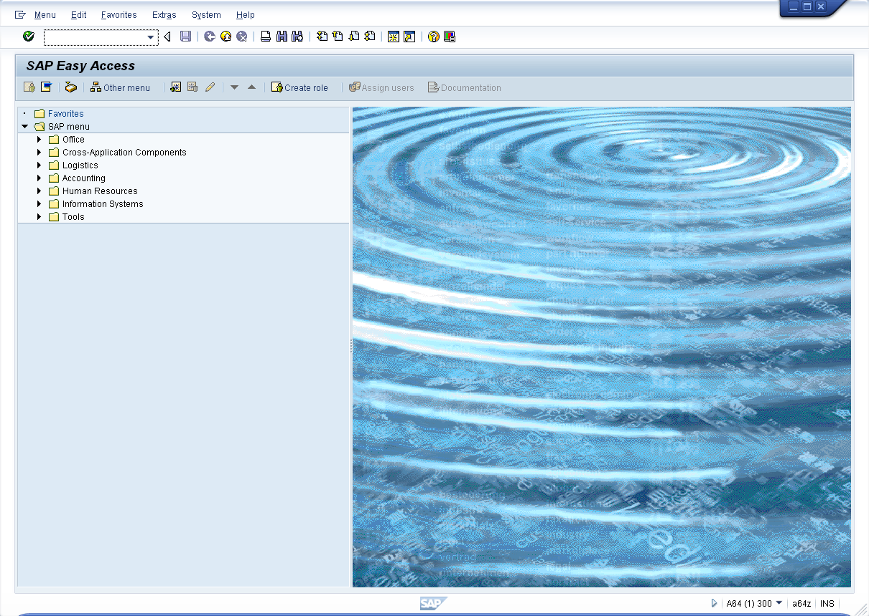
SAP Easy Access Menu

Slide 7
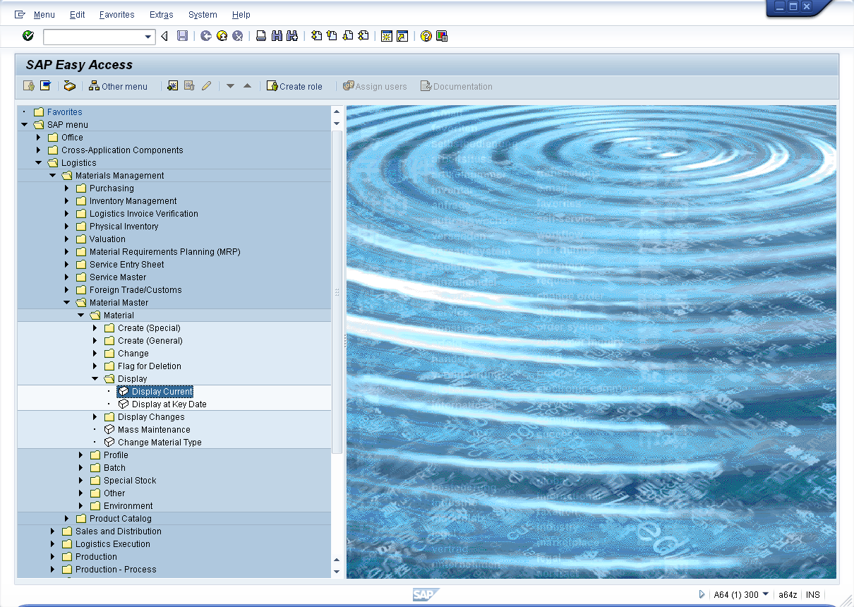
SAP Easy Access Menu

Slide 8
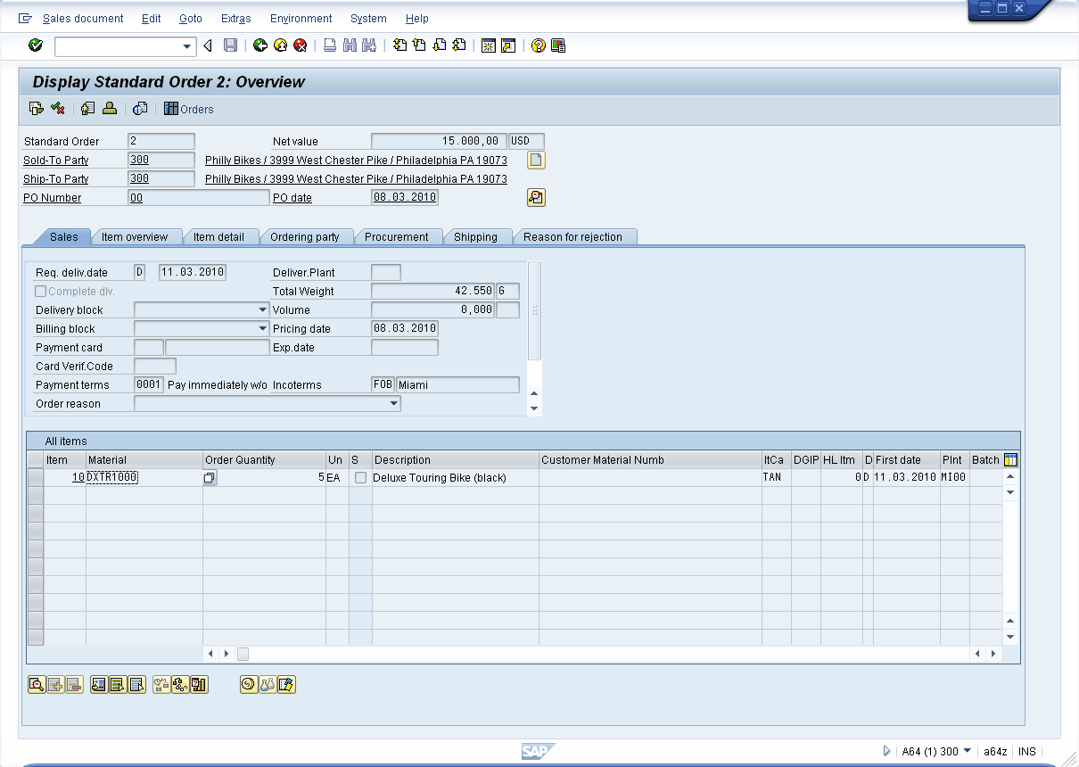
GUI Design
Header data
Position overview
Position details

Slide 9
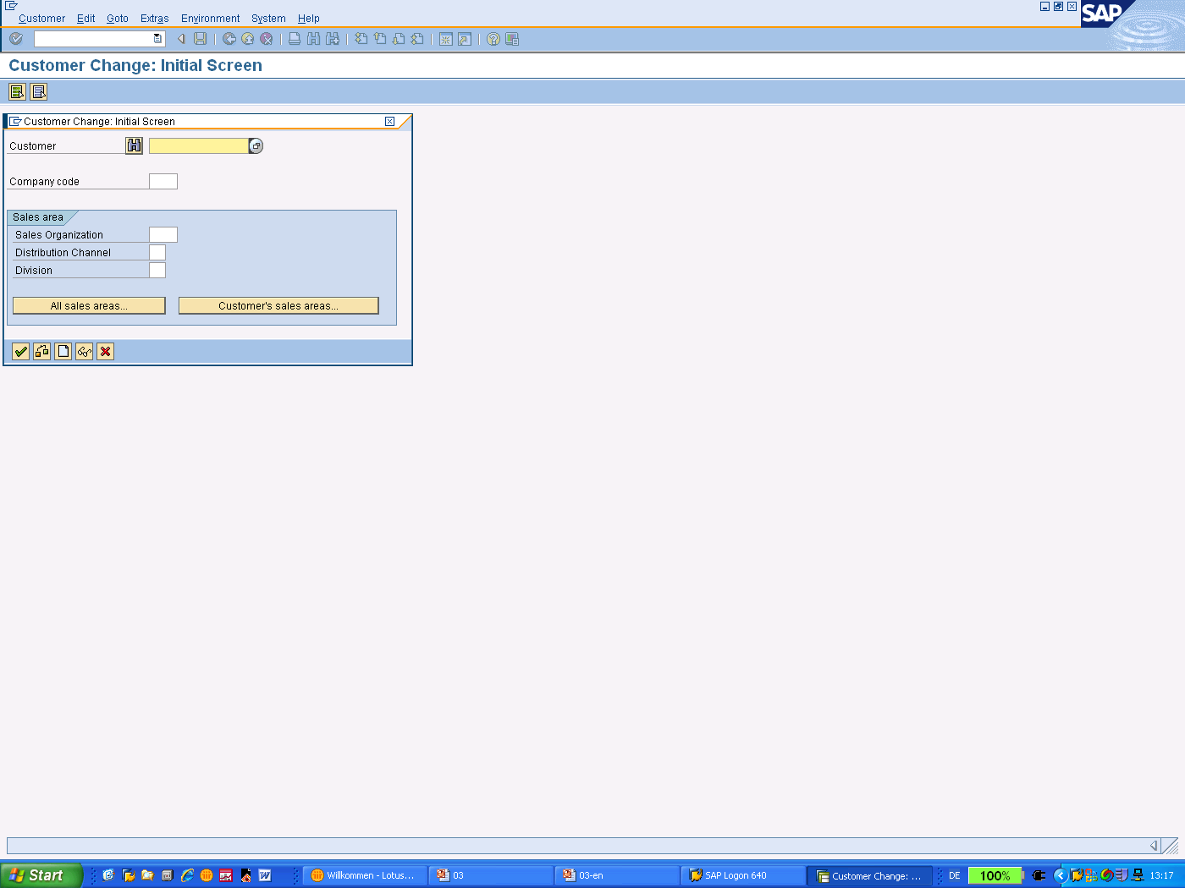
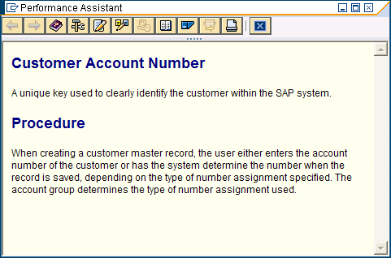
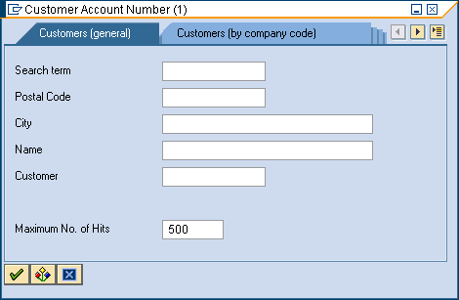
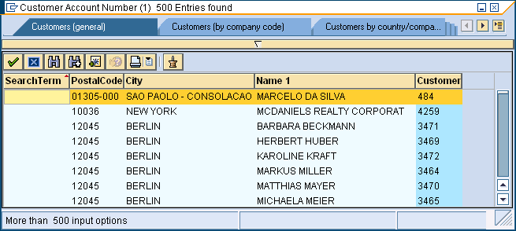
Help Functions
F1: Description of input fields
F4: Value list

Slide 10
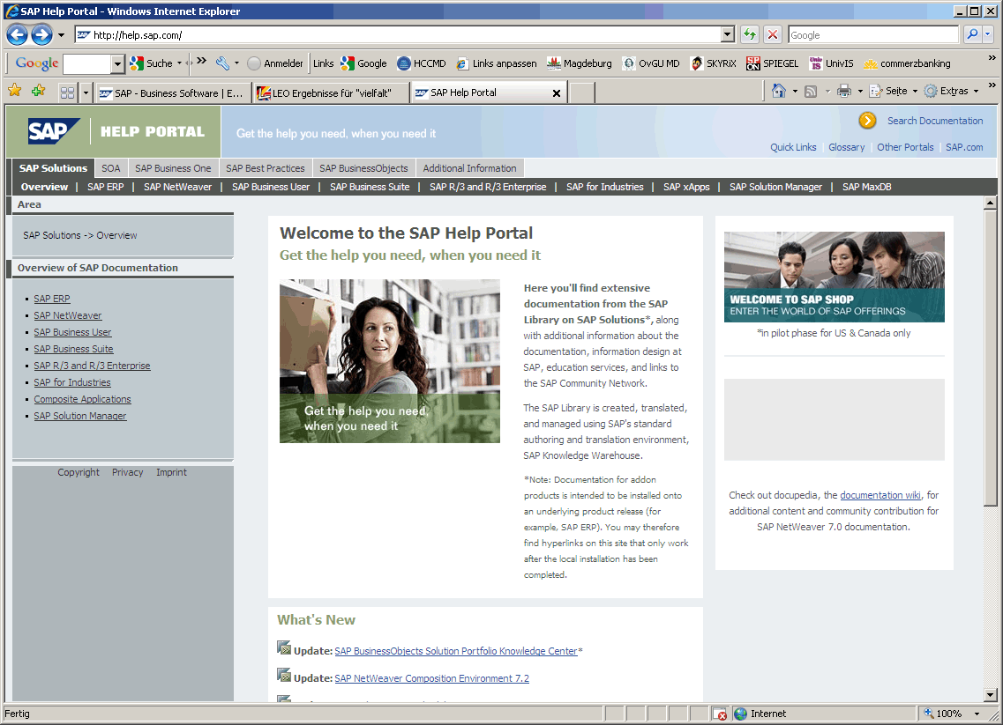
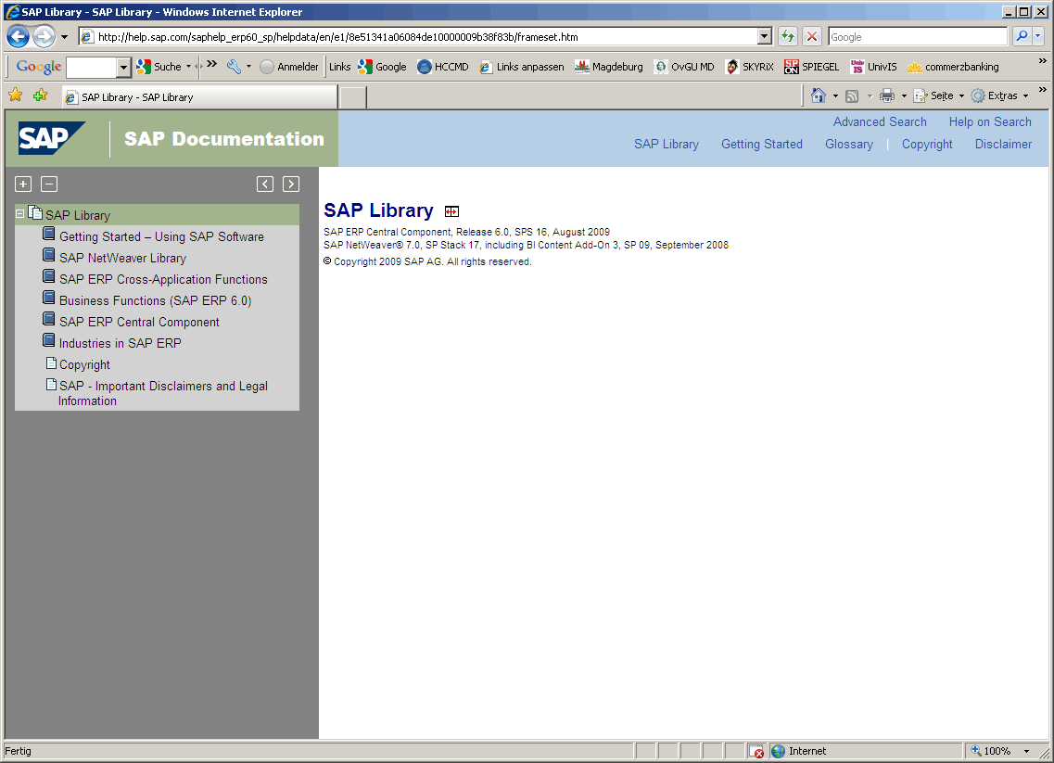
SAP Help Portal
http://help.sap.com

Slide 11
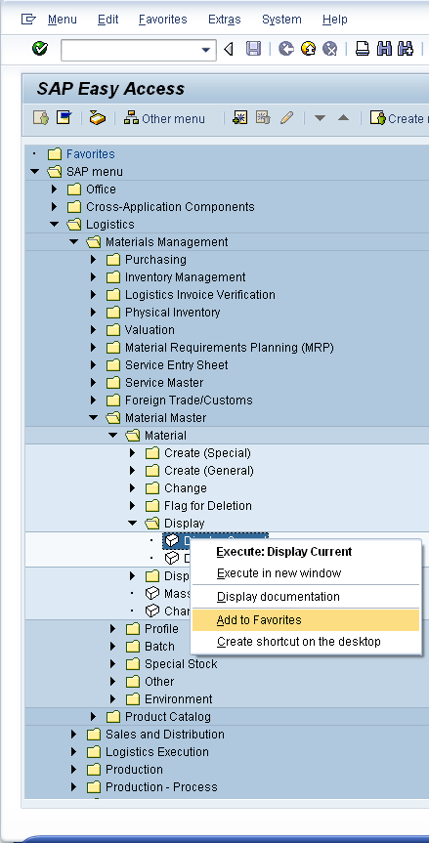
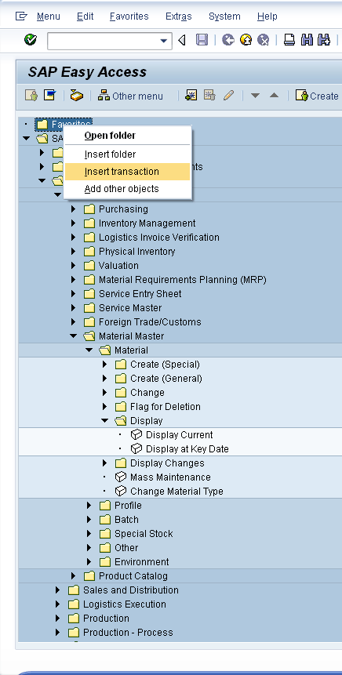
Favorites

Slide 12
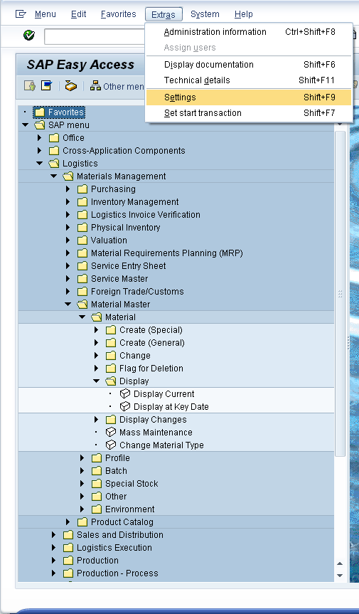
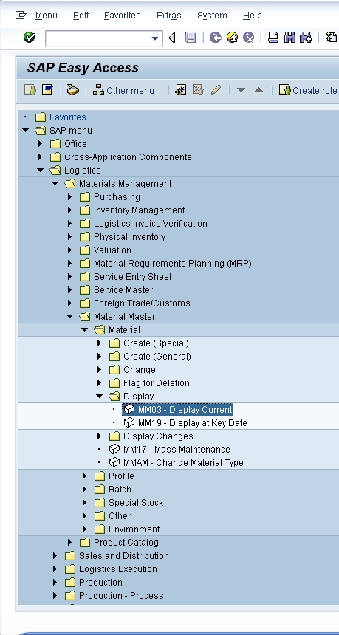
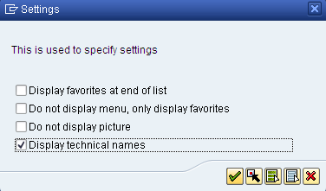
Transaction Codes

Slide 13
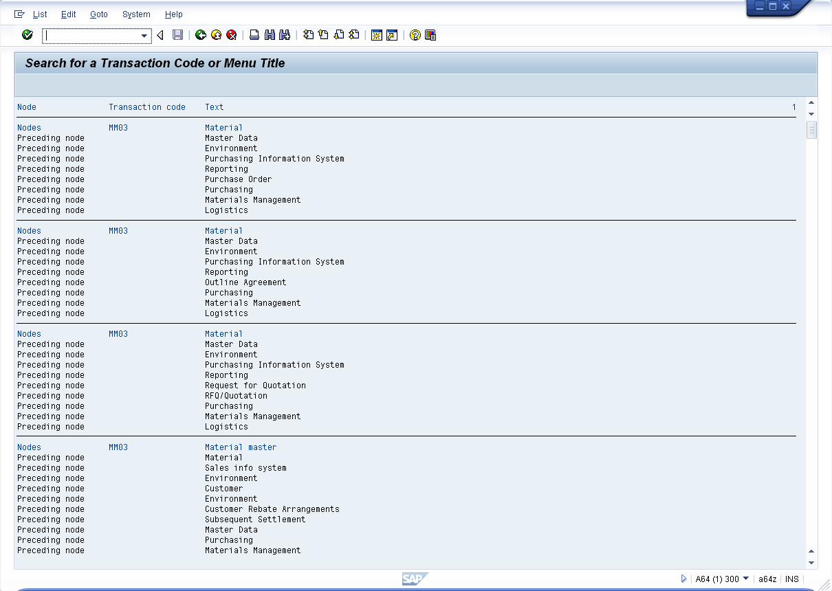
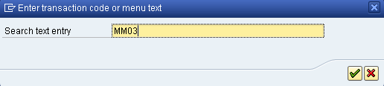
Transaction SEARCH_SAP_MENU

Slide 14
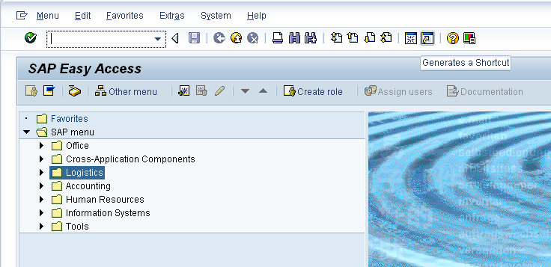
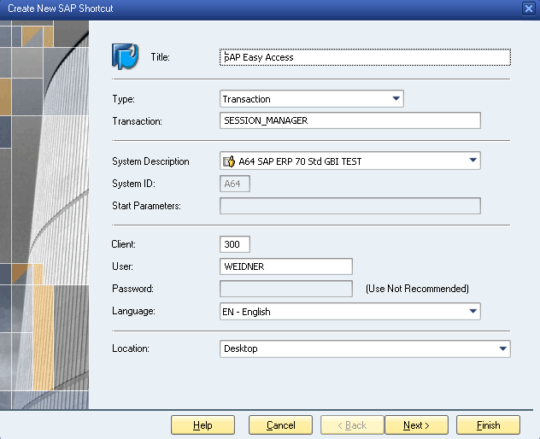
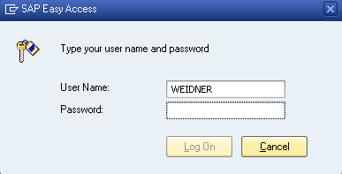
Desktop Shortcut

Slide 15
Summary
You are now able to:
name the window elements,
navigate in an SAP system,
effectively use help.

Slide 16
Question and Answer Session
Q & A

Slide 17
What we will cover next
Fulfillment

